Slide 1
Chapter 8 FSM Minimization
Fall 2018
Logic Design
CSE, SNU

Slide 2
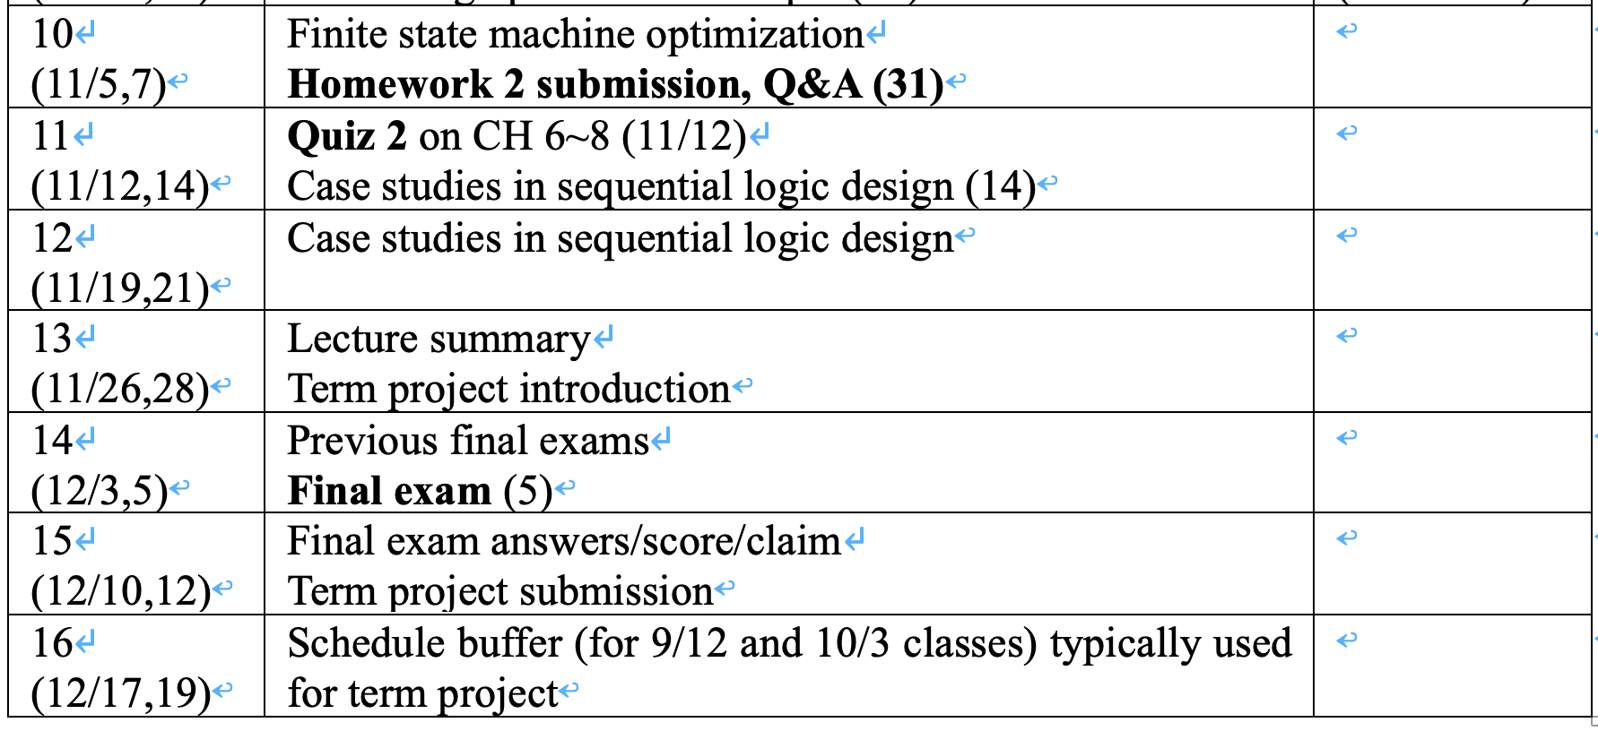
Schedule

Slide 3
Example: Vending Machine
Suitable Abstract Representation
Tabulate typical input sequences:
3 nickels
nickel, dime
dime, nickel
two dimes
Draw state diagram:
Inputs: N, D, reset
Output: open chute
Assumptions:
Assume N and D asserted for one cycle
Each state has a self loop for N = D = 0 (no coin)
Reset
S0
N
D
S1
S2
N
D
N
D
S3
S4
[open]
S5
[open]
S6
[open]
N
S7
[open]

Slide 4
Example: Vending Machine
present inputs next output state D N state open S0 0 0 S0 0 0 1 S1 0 1 0 S2 0 1 1 – – S1 0 0 S1 0 0 1 S3 0 1 0 S4 0 1 1 – – S2 0 0 S2 0 0 1 S5 0 1 0 S6 0 1 1 – – S3 0 0 S3 0 0 1 S7 0 1 – – – S4 – – S4 1 S5 – – S5 1 S6 – – S6 1 S7 – – S7 1
State Diagram
Reset
S0
N
D
S1
S2
N
D
N
D
S3
S4
[open]
S5
[open]
S6
[open]
N
S7
[open]
symbolic state table

Slide 5
Example: Vending Machine
State Encoding and Truth Table
Present state inputs next state output Q2 Q1 Q0 D N D2 D1 D0 open 0 0 0 0 0 0 0 0 0 0 1 0 0 1 0 1 0 0 1 0 0 1 1 – – – – 0 0 1 0 0 0 0 1 0 0 1 0 1 1 0 1 0 1 0 0 0 1 1 – – – – 0 1 0 0 0 0 1 0 0 0 1 1 0 1 0 1 0 1 1 0 0 1 1 – – – – 0 1 1 0 0 0 1 1 0 0 1 1 1 1 0 1 – – – – – 1 0 0 – – 1 0 0 1 1 0 1 – – 1 0 1 1 1 1 0 – – 1 1 0 1 1 1 1 – – 1 1 1 1

Slide 6
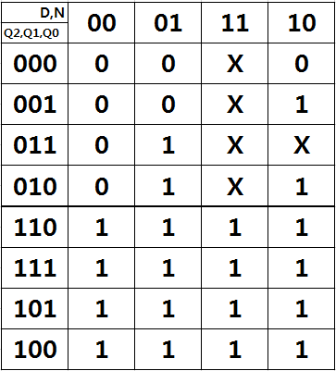
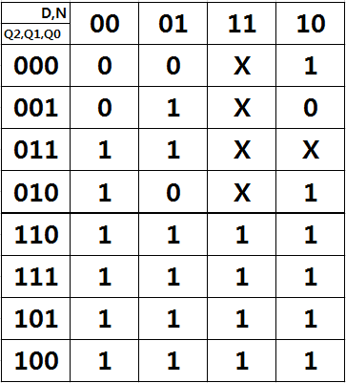
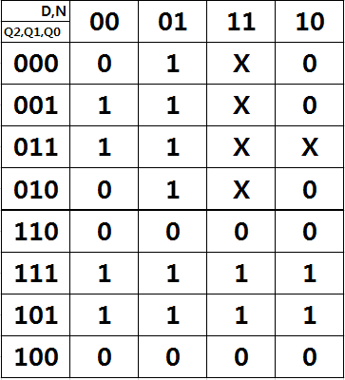
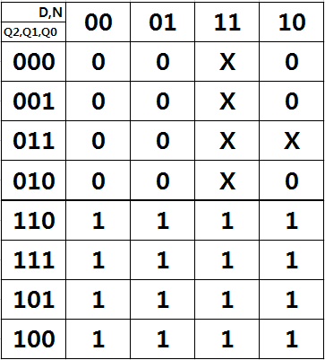
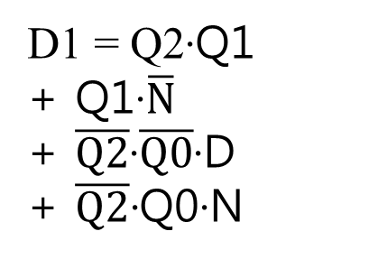
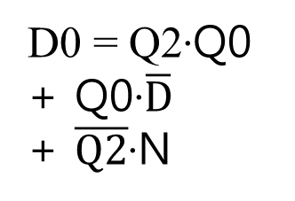
Example: Vending Machine
Implementation: D2, D1, D0, Open
D2 = Q2 + Q0·D + Q1·N + Q1·D
Open = Q2

Slide 7
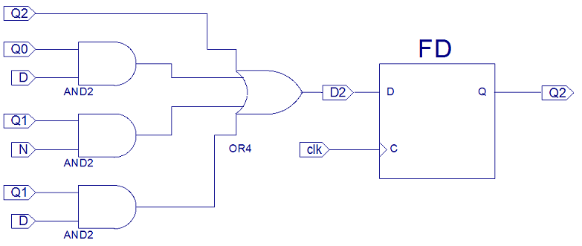
Example: Vending Machine
Implementation: D2

Slide 8
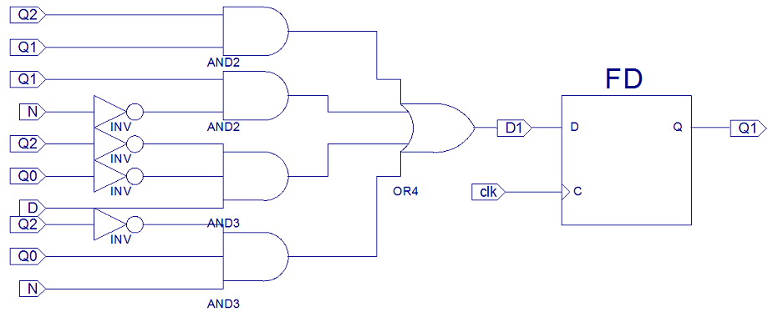
Example: Vending Machine
Implementation: D1

Slide 9
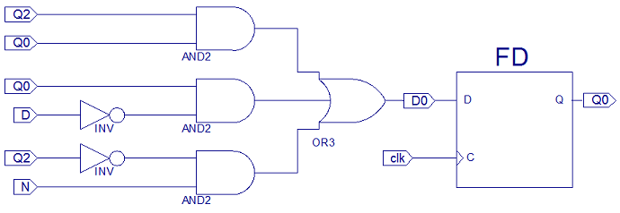
Example: Vending Machine
Implementation: D0

Slide 10
Example: Vending Machine
Implementation: Open
13 gates + 3 F/Fs

Slide 11
Example: Vending Machine (cont’d)
Minimize number of states - reuse states whenever possible
Reset
present inputs next output state D N state open 0¢ 0 0 0¢ 0 0 1 5¢ 0 1 0 10¢ 0 1 1 – – 5¢ 0 0 5¢ 0 0 1 10¢ 0 1 0 15¢ 0 1 1 – – 10¢ 0 0 10¢ 0 0 1 15¢ 0 1 0 15¢ 0 1 1 – – 15¢ – – 15¢ 1
0¢
N
5¢
D
N
D
10¢
N
15¢
[open]
symbolic state table

Slide 12
Example: Vending Machine (cont’d)
Uniquely Encode States
present state inputs next state output Q1 Q0 D N D1 D0 open 0 0 0 0 0 0 0 0 1 0 1 0 1 0 1 0 0 1 1 – – – 0 1 0 0 0 1 0 0 1 1 0 0 1 0 1 1 0 1 1 – – – 1 0 0 0 1 0 0 0 1 1 1 0 1 0 1 1 0 1 1 – – – 1 1 – – 1 1 1
0¢
5¢
10¢
15¢

Slide 13
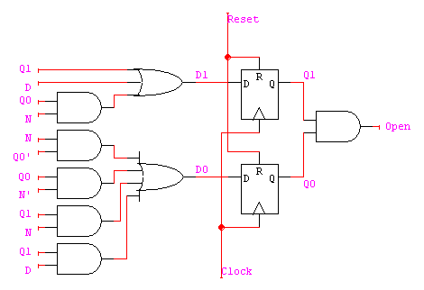
Example: Vending Machine (cont’d)
Mapping to Logic
D1
Q1
D0
Q1
Open
Q1
0 0 1 1
0 1 1 1
X X X X
1 1 1 1
0 1 1 0
1 0 1 1
X X X X
0 1 1 1
0 0 1 0
0 0 1 0
X X X X
0 0 1 0
N
N
N
D
D
D
Q0
Q0
Q0
D1 = Q1 + D + Q0 N
D0 = Q0’ N + Q0 N’ + Q1 N + Q1 D
OPEN = Q1 Q0
8 gates + 2 F/Fs
13 gates + 3 F/Fs

Slide 14
Finite State Machine Optimization
State Minimization
Fewer states require fewer state bits
Fewer bits require fewer logic equations
Encodings: State, Inputs, Outputs
State encoding with fewer bits has fewer equations to implement
However, each may be more complex
State encoding with more bits (e.g., one-hot) has simpler equations
Complexity directly related to complexity of state diagram
Input/output encoding may or may not be under designer control

Slide 15
State Minimization Example
Sequence Detector for 010 or 110
Input Next State Output
Sequence Present State X=0 X=1 X=0 X=1
Reset S0 S1 S2 0 0
0 S1 S3 S4 0 0
1 S2 S5 S6 0 0
00 S3 S0 S0 0 0
01 S4 S0 S0 1 0
10 S5 S0 S0 0 0
11 S6 S0 S0 1 0
S0
0/0
1/0
S1
S2
0/0
1/0
0/0
1/0
S3
S4
S5
S6
1/0
1/0
1/0
1/0
0/0
0/1
0/0
0/1

Slide 16
Algorithmic Approach to State Minimization
Goal – identify and combine states that have equivalent behavior
Equivalent States:
Same output (behavior)
For all input combinations, states transition to same or equivalent states
Row Matching Method: Algorithm Sketch
1. Place all states in one set
2. Initially partition set based on output behavior
3. Successively partition resulting subsets based on next state transitions
4. Repeat (3) until no further partitioning is required
states left in the same set are equivalent
Polynomial time procedure

Slide 17
Method of Successive Partitions
Input Next State Output
Sequence Present State X=0 X=1 X=0 X=1
Reset S0 S1 S2 0 0
0 S1 S3 S4 0 0
1 S2 S5 S6 0 0
00 S3 S0 S0 0 0
01 S4 S0 S0 1 0
10 S5 S0 S0 0 0
11 S6 S0 S0 1 0
( S0 S1 S2 S3 S4 S5 S6 )
( S0 S1 S2 S3 S5 ) ( S4 S6 )
( S0 S3 S5 ) ( S1 S2 ) ( S4 S6 )
( S0 ) ( S3 S5 ) ( S1 S2 ) ( S4 S6 )
S1 is equivalent to S2
S3 is equivalent to S5
S4 is equivalent to S6

Slide 18
Method of Successive Partitions
Input Next State Output
Sequence Present State X=0 X=1 X=0 X=1
Reset S0 S1 S2 0 0
0 S1 S3 S4 0 0
1 S2 S5 S6 0 0
00 S3 S0 S0 0 0
01 S4 S0 S0 1 0
10 S5 S0 S0 0 0
11 S6 S0 S0 1 0
( S0 S1 S2 S3 S4 S5 S6 )
( S0 S1 S2 S3 S5 ) ( S4 S6 )
S4 and S6 have the same
output behavior (1 0) and
state transition behavior (S0 S0)

Slide 19
Method of Successive Partitions
Input Next State Output
Sequence Present State X=0 X=1 X=0 X=1
Reset S0 S1 S2 0 0
0 S1 S3 S4 0 0
1 S2 S5 S6 0 0
00 S3 S0 S0 0 0
01 S4 S0 S0 1 0
10 S5 S0 S0 0 0
11 S6 S0 S0 1 0
A
A
A
B
A
B
A
A
A
A
A
A
A
A
( S0 S1 S2 S3 S4 S5 S6 )
( S0 S1 S2 S3 S5 ) ( S4 S6 )
( S0 S3 S5 ) ( S1 S2 ) ( S4 S6 )
( S0 ) ( S3 S5 ) ( S1 S2 ) ( S4 S6 )
A
B

Slide 20
Method of Successive Partitions
Input Next State Output
Sequence Present State X=0 X=1 X=0 X=1
Reset S0 S1 S2 0 0
0 S1 S3 S4 0 0
1 S2 S5 S6 0 0
00 S3 S0 S0 0 0
01 S4 S0 S0 1 0
10 S5 S0 S0 0 0
11 S6 S0 S0 1 0
A
A
A
B
A
B
A
A
A
A
A
A
A
A
( S0 S1 S2 S3 S4 S5 S6 )
( S0 S1 S2 S3 S5 ) ( S4 S6 )
( S0 S3 S5 ) ( S1 S2 ) ( S4 S6 )
( S0 ) ( S3 S5 ) ( S1 S2 ) ( S4 S6 )
A
B

Slide 21
Method of Successive Partitions
Input Next State Output
Sequence Present State X=0 X=1 X=0 X=1
Reset S0 S1 S2 0 0
0 S1 S3 S4 0 0
1 S2 S5 S6 0 0
00 S3 S0 S0 0 0
01 S4 S0 S0 1 0
10 S5 S0 S0 0 0
11 S6 S0 S0 1 0
A
A
A
B
A
B
A
A
A
A
A
A
A
A
( S0 S1 S2 S3 S4 S5 S6 )
( S0 S1 S2 S3 S5 ) ( S4 S6 )
( S0 S3 S5 ) ( S1 S2 ) ( S4 S6 )
( S0 ) ( S3 S5 ) ( S1 S2 ) ( S4 S6 )
A
B

Slide 22
Method of Successive Partitions
Input Next State Output
Sequence Present State X=0 X=1 X=0 X=1
Reset S0 S1 S2 0 0
0 S1 S3 S4 0 0
1 S2 S5 S6 0 0
00 S3 S0 S0 0 0
01 S4 S0 S0 1 0
10 S5 S0 S0 0 0
11 S6 S0 S0 1 0
D
D
C
E
C
E
C
C
C
C
C
C
C
C
( S0 S1 S2 S3 S4 S5 S6 )
( S0 S1 S2 S3 S5 ) ( S4 S6 )
( S0 S3 S5 ) ( S1 S2 ) ( S4 S6 )
( S0 ) ( S3 S5 ) ( S1 S2 ) ( S4 S6 )
C
D
E

Slide 23
Method of Successive Partitions
Input Next State Output
Sequence Present State X=0 X=1 X=0 X=1
Reset S0 S1 S2 0 0
0 S1 S3 S4 0 0
1 S2 S5 S6 0 0
00 S3 S0 S0 0 0
01 S4 S0 S0 1 0
10 S5 S0 S0 0 0
11 S6 S0 S0 1 0
D
D
C
E
C
E
C
C
C
C
C
C
C
C
( S0 S1 S2 S3 S4 S5 S6 )
( S0 S1 S2 S3 S5 ) ( S4 S6 )
( S0 S3 S5 ) ( S1 S2 ) ( S4 S6 )
( S0 ) ( S3 S5 ) ( S1 S2 ) ( S4 S6 )
C
D
E

Slide 24
Method of Successive Partitions
Input Next State Output
Sequence Present State X=0 X=1 X=0 X=1
Reset S0 S1 S2 0 0
0 S1 S3 S4 0 0
1 S2 S5 S6 0 0
00 S3 S0 S0 0 0
01 S4 S0 S0 1 0
10 S5 S0 S0 0 0
11 S6 S0 S0 1 0
D
D
C
E
C
E
C
C
C
C
C
C
C
C
( S0 S1 S2 S3 S4 S5 S6 )
( S0 S1 S2 S3 S5 ) ( S4 S6 )
( S0 S3 S5 ) ( S1 S2 ) ( S4 S6 )
( S0 ) ( S3 S5 ) ( S1 S2 ) ( S4 S6 )
S1 is equivalent to S2
S3 is equivalent to S5
S4 is equivalent to S6
C
D
E

Slide 25
Minimized FSM
State minimized sequence detector for 010 or 110
Input Next State Output
Sequence Present State X=0 X=1 X=0 X=1
Reset S0 S1' S1' 0 0
0 + 1 S1' S3' S4' 0 0
X0 S3' S0 S0 0 0
X1 S4' S0 S0 1 0
S0
S0
X/0
0/0
1/0
S1’
S1
S2
0/0
1/0
0/0
1/0
0/0
1/0
S3’
S4’
S3
S4
S5
S6
1/0
1/0
1/0
1/0
X/0
0/1
1/0
0/0
0/1
0/0
0/1
( S0 ) ( S3 S5 ) ( S1 S2 ) ( S4 S6 )

Slide 26
Minimized FSM
State minimized sequence detector for 010 or 110
Input Next State Output
Sequence Present State X=0 X=1 X=0 X=1
Reset S0 S1' S1' 0 0
0 + 1 S1' S3' S4' 0 0
X0 S3' S0 S0 0 0
X1 S4' S0 S0 1 0
S0
S0
X/0
0/0
1/0
S1’
S1
S2
0/0
1/0
0/0
1/0
0/0
1/0
S3’
S4’
S3
S4
S5
S6
1/0
1/0
1/0
1/0
X/0
0/1
1/0
0/0
0/1
0/0
0/1
( S0 ) ( S3 S5 ) ( S1 S2 ) ( S4 S6 )

Slide 27
Minimized FSM: A Simple Illustration
State minimized sequence detector for 010 or 110
Input Next State Output
Sequence Present State X=0 X=1 X=0 X=1
Reset S0 S1' S1' 0 0
0 + 1 S1' S3' S4' 0 0
X0 S3' S0 S0 0 0
X1 S4' S0 S0 1 0
S0
S0
X/0
0/0
1/0
S1’
S1
S2
0/0
1/0
0/0
1/0
0/0
1/0
S3’
S4’
S3’
S4’
X/0
0/1
1/0
X/0
0/1
1/0
( S0 ) ( S3 S5 ) ( S1 S2 ) ( S4 S6 )

Slide 28
Minimized FSM
State minimized sequence detector for 010 or 110
Input Next State Output
Sequence Present State X=0 X=1 X=0 X=1
Reset S0 S1' S1' 0 0
0 + 1 S1' S3' S4' 0 0
X0 S3' S0 S0 0 0
X1 S4' S0 S0 1 0
S0
State
Minimization!
S0
X/0
0/0
1/0
S1’
S1
S2
0/0
1/0
0/0
1/0
0/0
1/0
S3’
S4’
S3
S4
S5
S6
1/0
1/0
1/0
1/0
X/0
0/1
1/0
0/0
0/1
0/0
0/1

Slide 29
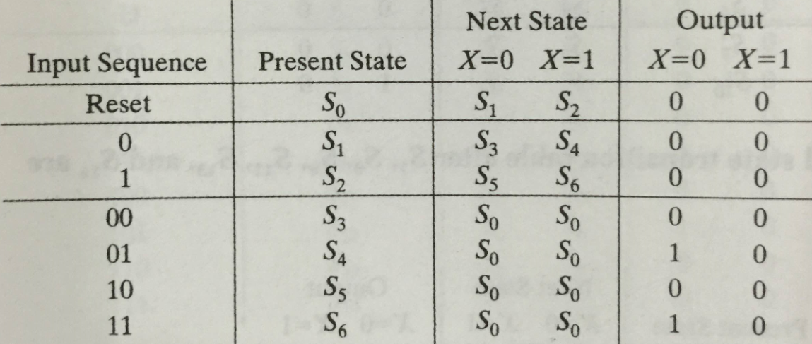
Implication Chart Method
3-bit sequence detector example
Take 3 bits as input. Output = 1 in case of 010 or 110

Slide 30
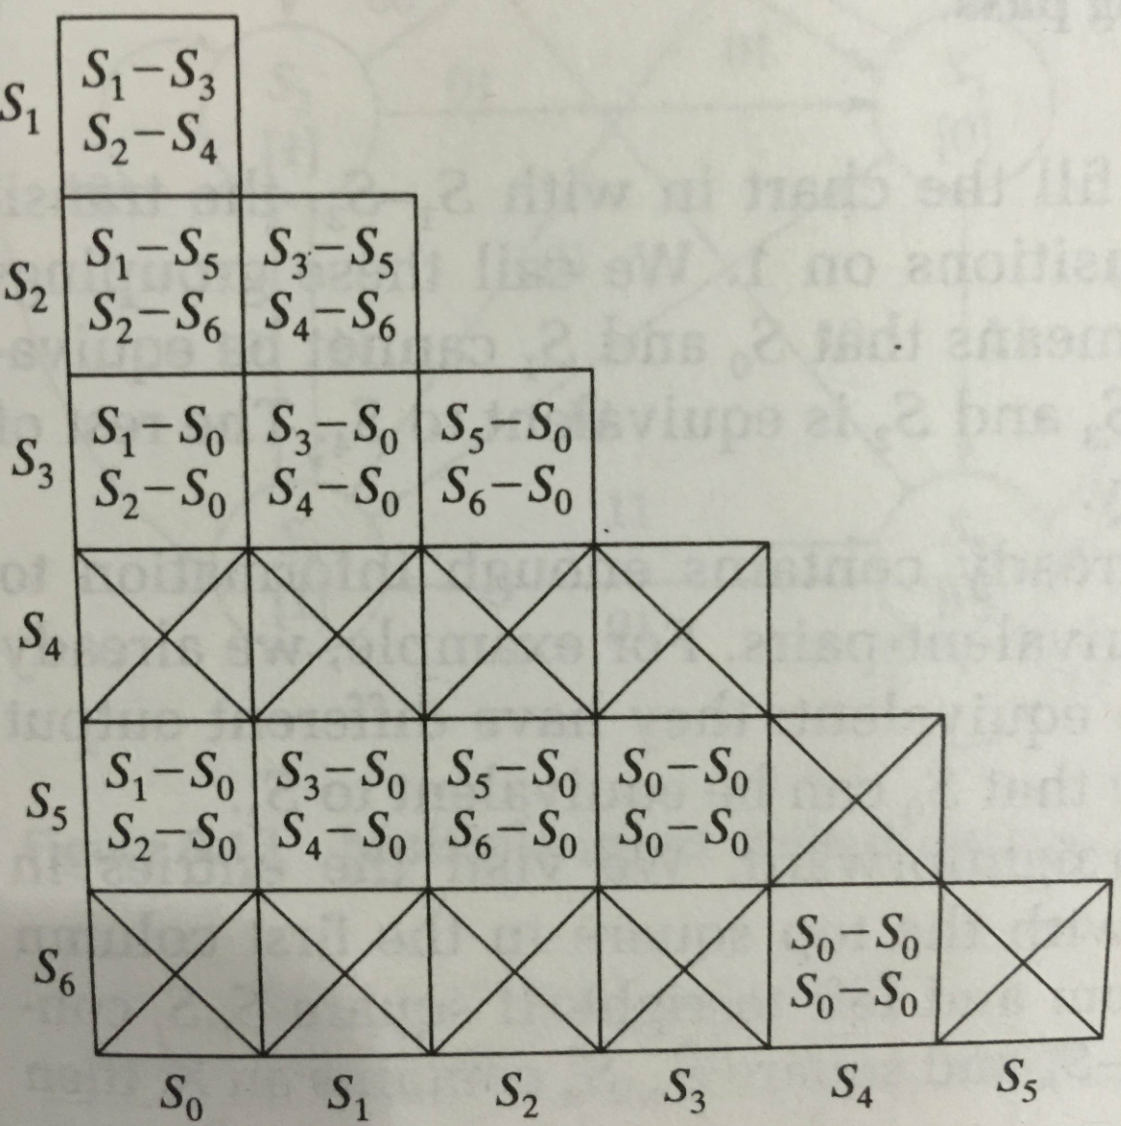
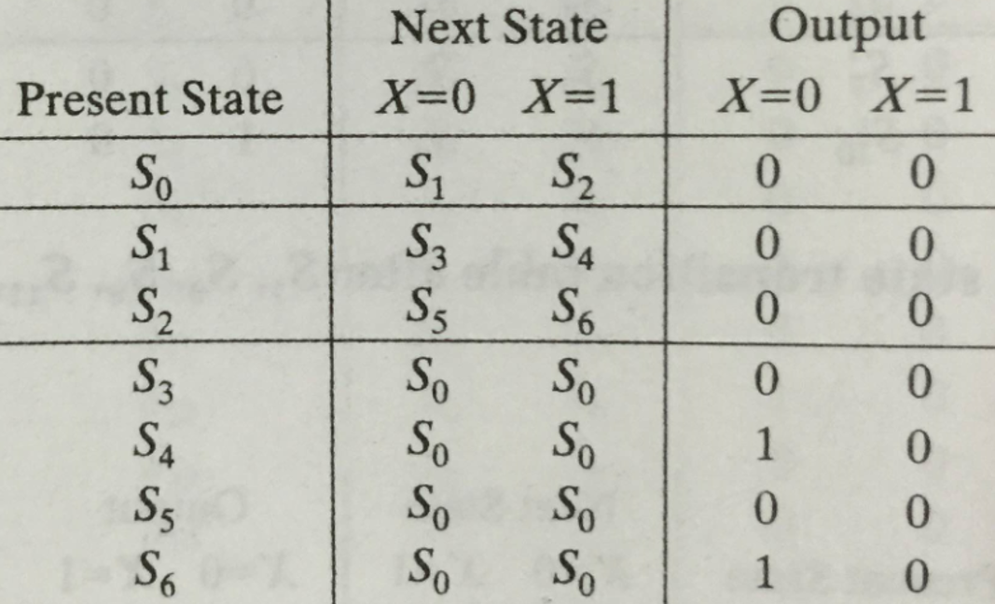
Implication Chart Method: 3-bit seq. detector

Slide 31
Implication Chart Method: 3-bit seq. detector
Check each equivalence candidate from top to down and left to right
For each candidate, check to see if the next states are the same for each transition
If not the same, cross out the candidate since the two states of the candidate have different state transition behavior

Slide 32
Implication Chart Method: 3-bit seq. detector
Check each equivalence candidate from top to down and left to right
For each candidate, check to see if the next states are the same for each transition
If not the same, cross out the candidate since the two states of the candidate have different state transition behavior

Slide 33
Implication Chart Method: 3-bit seq. detector
Check each equivalence candidate from top to down and left to right
For each candidate, check to see if the next states are the same for each transition
If not the same, cross out the candidate since the two states of the candidate have different state transition behavior

Slide 34
Implication Chart Method: 3-bit seq. detector
Check each equivalence candidate from top to down and left to right
For each candidate, check to see if the next states are the same for each transition
If not the same, cross out the candidate since the two states of the candidate have different state transition behavior

Slide 35
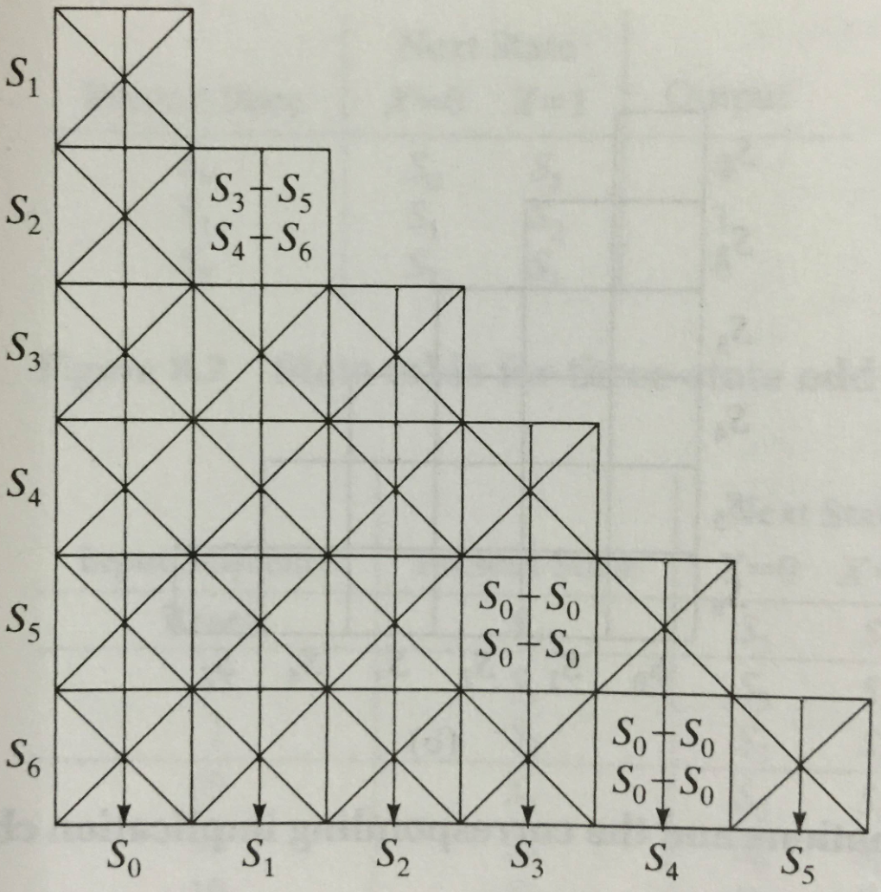
Results
S3=S5, S4=S6, S1=S2

Slide 36
More Complex State Minimization
Multiple input example
inputs here
00
10
S0 [1]
00
S1
[0]
01
present next state output state 00 01 10 11 S0 S0 S1 S2 S3 1 S1 S0 S3 S1 S4 0 S2 S1 S3 S2 S4 1 S3 S1 S0 S4 S5 0 S4 S0 S1 S2 S5 1 S5 S1 S4 S0 S5 0
10
11
11
00
01
00
01
S2 [1]
S3
[0]
01
10
11
10
11
01
10
10
00
S4 [1]
11
S5
[0]
00
symbolic state transition table
01
11

Slide 37
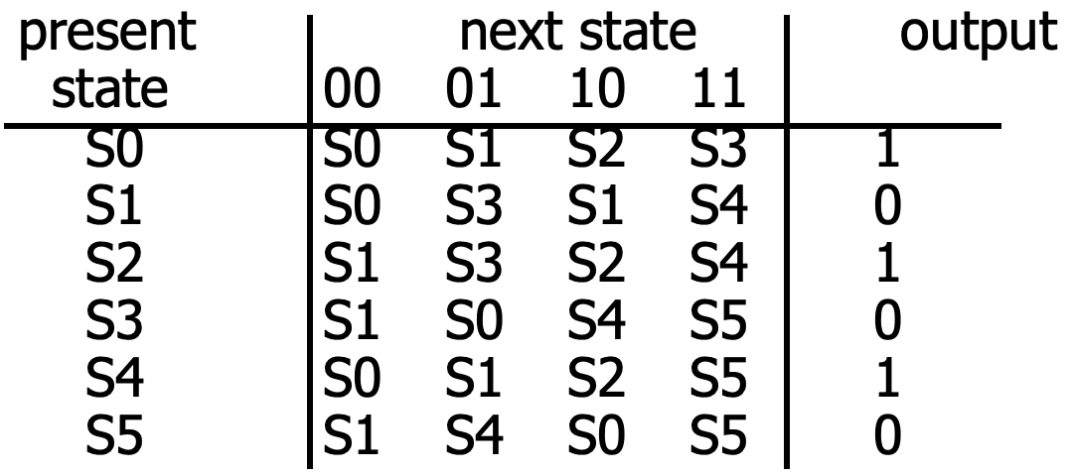
Minimized FSM
Implication Chart Method
Cross out incompatible states based on outputs
Then cross out more cells if indexed chart entries are already crossed out
S1
present next state output state 00 01 10 11 S0' S0' S1 S2 S3' 1 S1 S0' S3' S1 S3' 0 S2 S1 S3' S2 S0' 1 S3' S1 S0' S0' S3' 0
S0-S1
S2
S1-S3
S2-S2
S3-S4
S0-S1
S3
S3-S0
S1-S4
minimized state table
(S0==S4) (S3==S5)
S4-S5
S0-S0
S1-S0
S4
S1-S1
S3-S1
S2-S2
S2-S2
S3-S5
S4-S5
S0-S1
S1-S1
S5
S3-S4
S0-S4
S1-S0
S4-S0
S4-S5
S5-S5
S0
S1
S2
S3
S4

Slide 38
Summary: Finite State Machine Optimization
State Minimization
Fewer states require fewer state bits
Fewer bits require fewer logic equations
Encodings: State, Inputs, Outputs
State encoding with fewer bits has fewer equations to implement
However, each may be more complex
State encoding with more bits (e.g., one-hot) has simpler equations
Complexity directly related to complexity of state diagram
Input/output encoding may or may not be under designer control

Slide 39
Schedule

Slide 40
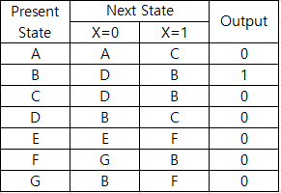
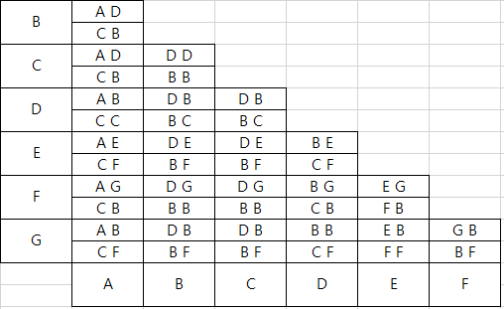
Exercise 8.5.
Implication chart method:

Slide 41
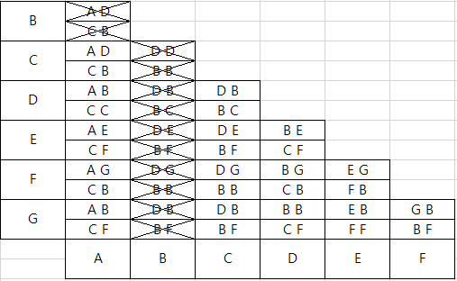
Exercise 8.5.
Implication chart method:
State B cannot be combined: different output

Slide 42
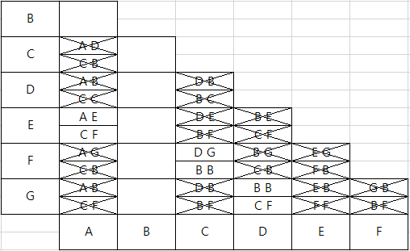
Exercise 8.5.
Implication chart method:
States cannot be combined which contains state B

Slide 43
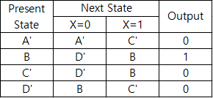
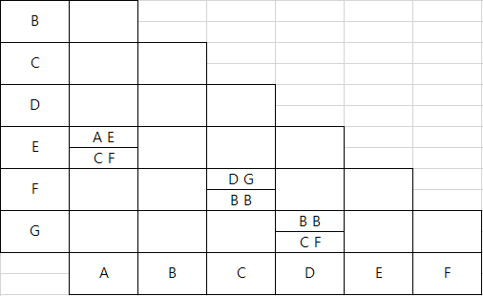
Exercise 8.5.
Implication chart method:
After state minimization
A’ ← A, E
C’ ← C, F
D’ ← D, G

Slide 44
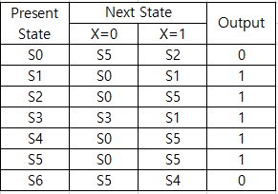
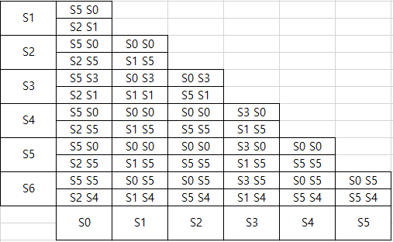
Exercise 8.6.
Implication chart method:

Slide 45
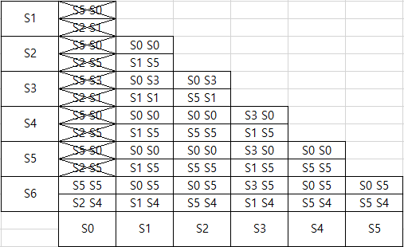
Exercise 8.6.
Implication chart method:
States which have different outputs cannot be combined

Slide 46
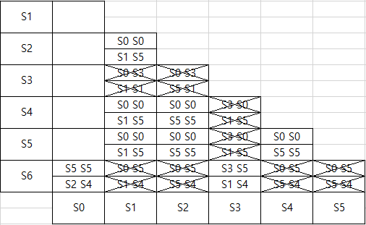
Exercise 8.6.
Implication chart method:
States cannot be combined which contains states already excluded

Slide 47
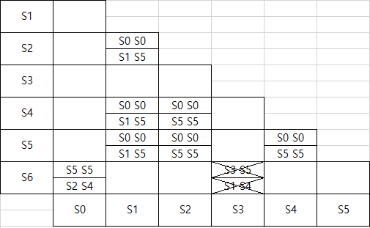
Exercise 8.6.
Implication chart method:
States cannot be combined which contains states already excluded

Slide 48
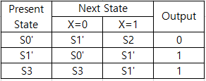
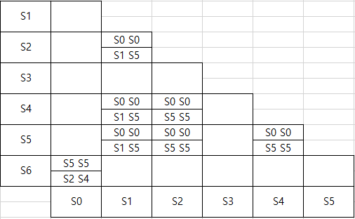
Exercise 8.6.
Implication chart method:
After state minimization
S0’ ← S0, S6
S1’ ← S1, S2, S4, S5
S0
0
0
S1
S5
1
1
Can be combined

Slide 49
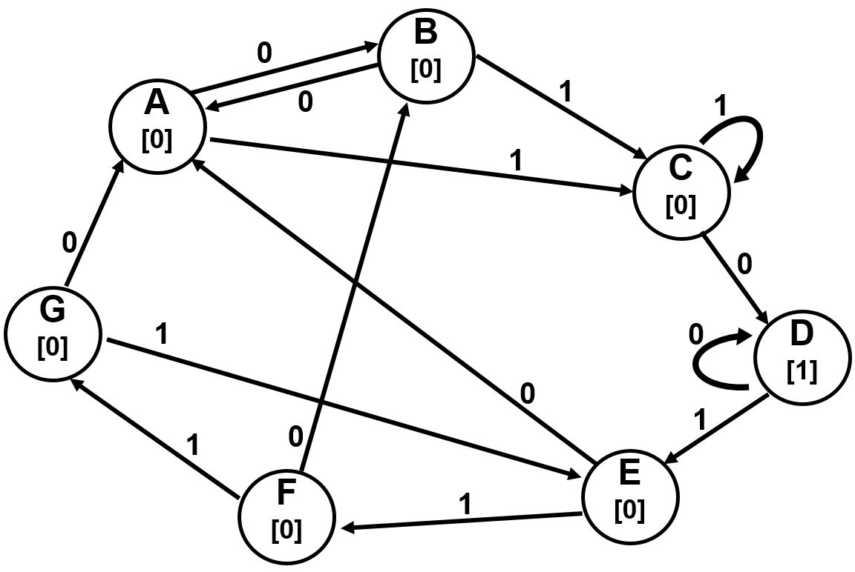
Exercise 8.2.
Given the state diagram in Figure below, obtain an equivalent reduced-state diagram containing a minimum number of states. You may use row-matching or implication charts. Put your final answer in the form of a state diagram rather than a state table. Make it clear which states have been combined.

Slide 50
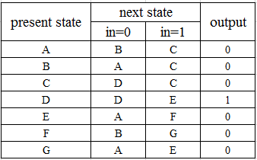
Exercise 8.2.
State transition table

Slide 51
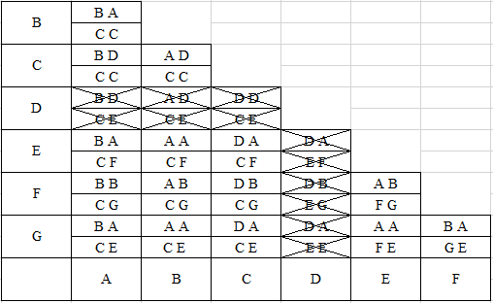
Exercise 8.2.
Implication chart method:
D cannot be equivalent to any others: different output behavior

Slide 52
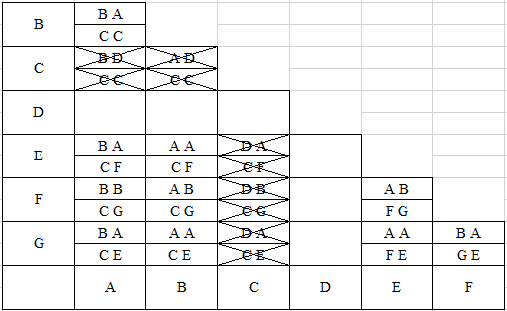
Exercise 8.2.
Implication chart method:
Cross out cells exploiting the fact that state D cannot be equivalent to any other state

Slide 53
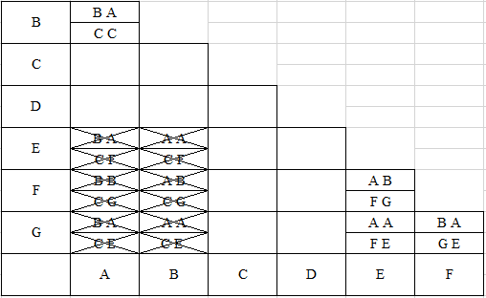
Exercise 8.2.
Implication chart method:
States in these state pairs cannot be combined due to the inequivalent states revealed in the previous cells

Slide 54
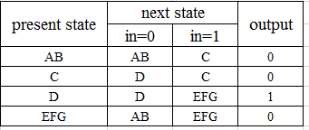
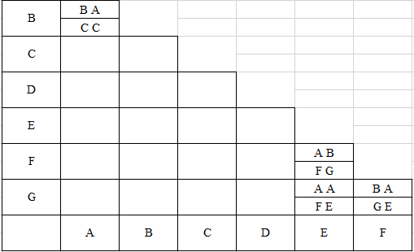
Exercise 8.2.
Implication chart method:
Final implication chart → State A and B can be combined
→ State E, F and G can be combined
C
AB
1
1
0
0
A
0
B
E
1
F
0
0
1
1
Can be combined
G
Can be combined

Slide 55
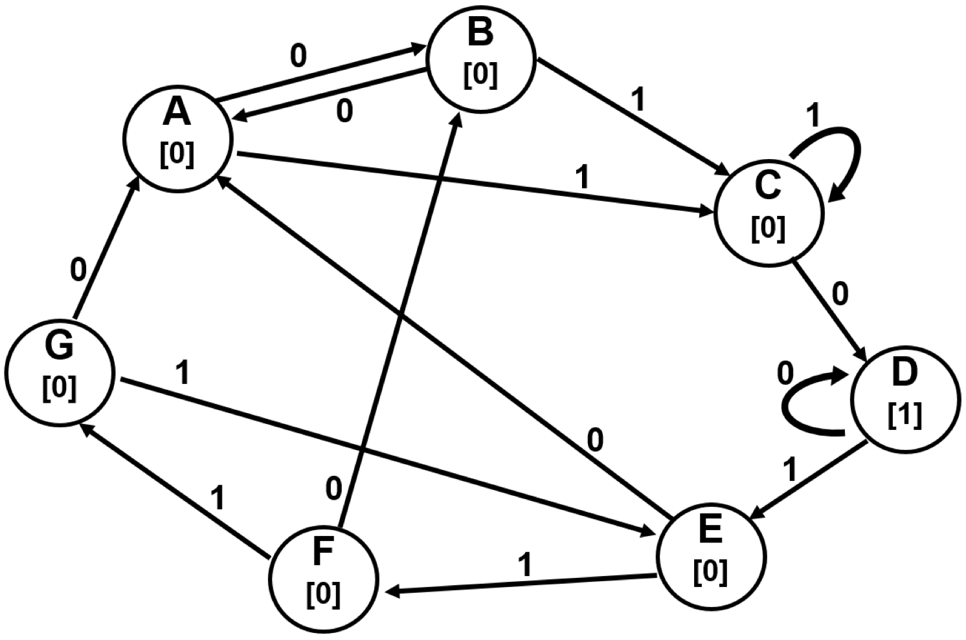
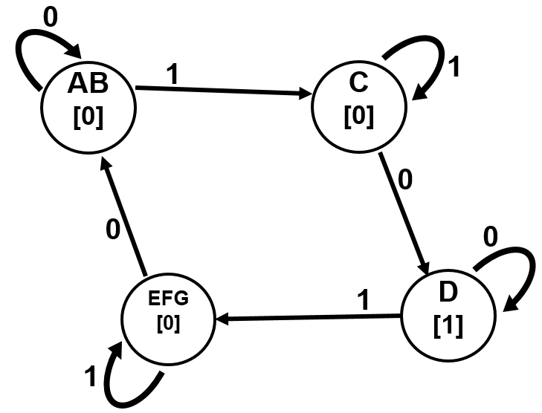
Exercise 8.2.
Implication chart method:
State diagram for minimized states

Slide 56
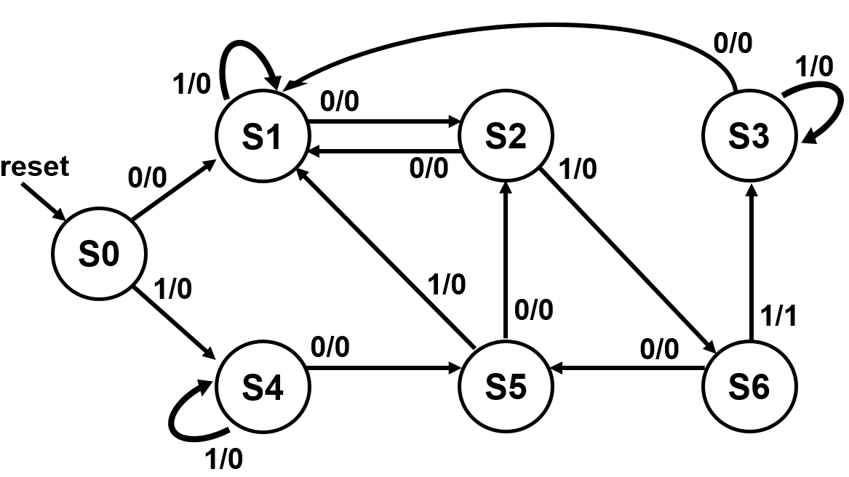
Exercise 8.4.
Given the state diagram in figure below, determine which states should be combined to determine the reduced state diagram. You may use row-matching or implication charts.

Slide 57
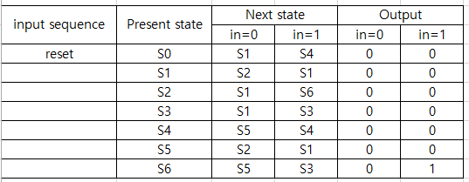
Exercise 8.4.
State transition table

Slide 58
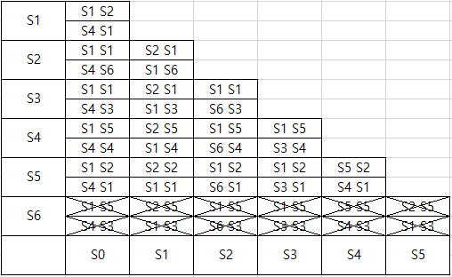
Exercise 8.4.
Implication chart method:
State S6 cannot be combined: different output

Slide 59
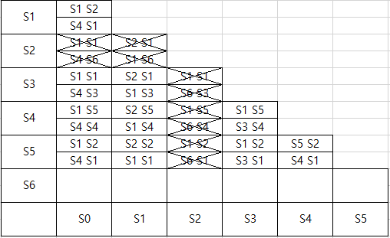
Exercise 8.4.
Implication chart method:
States cannot be combined which contains state S6

Slide 60
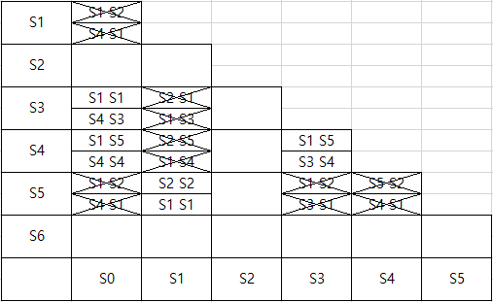
Exercise 8.4.
Implication chart method:
States cannot be combined which contains states already excluded, e.g., S2

Slide 61
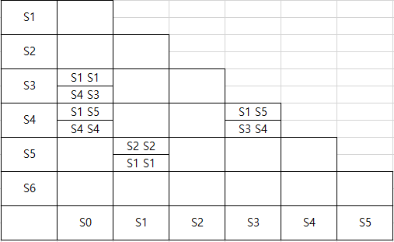
Exercise 8.4.
Implication chart method:
Final implication chart
S1=S5, S0=S4
S1,5
0
0
S3
S4
1
1
Can be combined

Slide 62
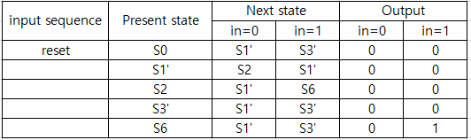
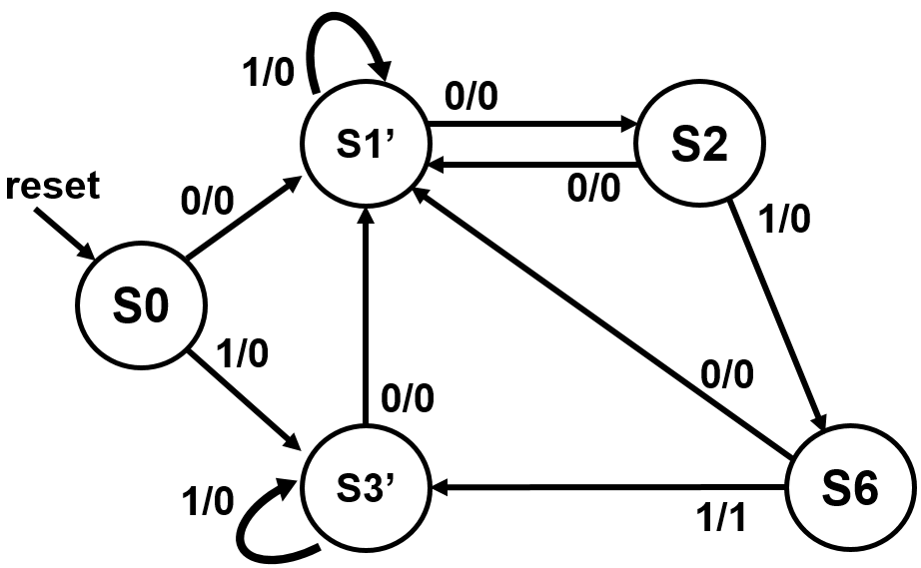
Exercise 8.4.
State diagram for minimized states

Slide 63
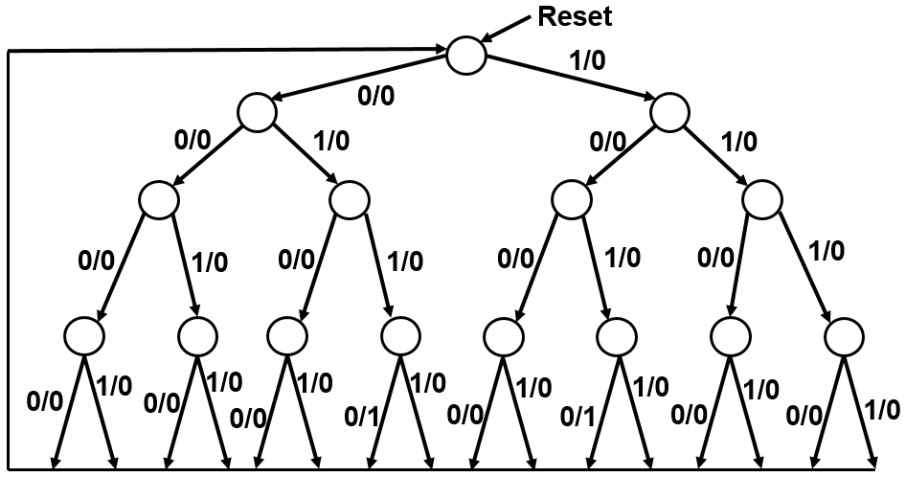
Exercise 8.3.
Create a Moore state diagram for the 4-bit string recognizer of figure below. Does it have more states than the Mealy version? Use the implication chart method to reduce the number of states. Do you end with more, less, or the same number of states? Why?

Slide 64
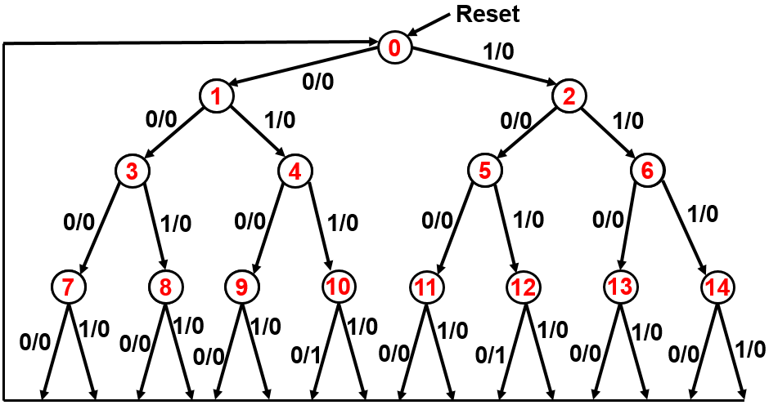
Exercise 8.3.
State transition table

Slide 65
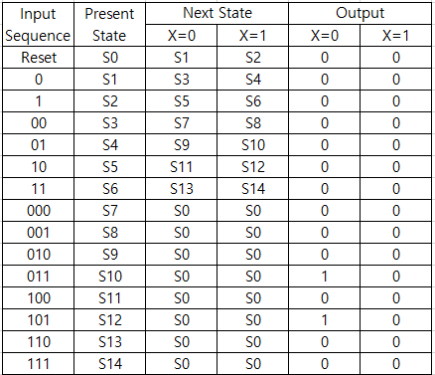
Exercise 8.3.
State transition table

Slide 66
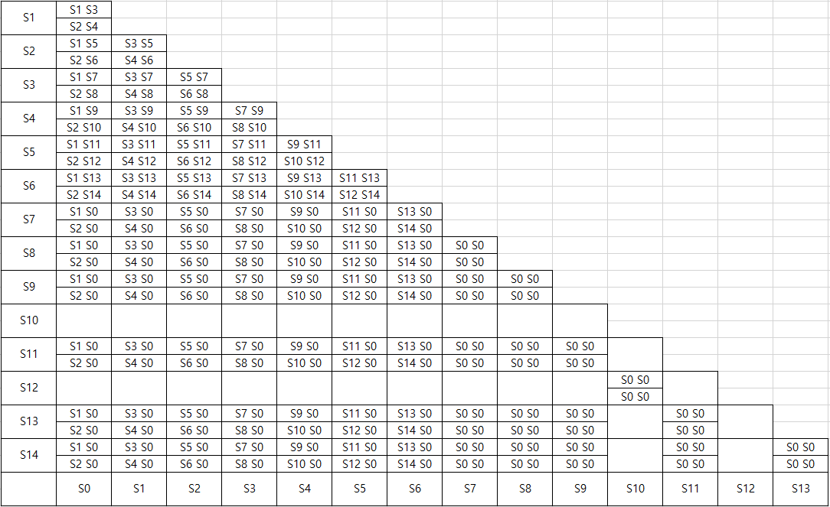
Exercise 8.3.
Implication chart method:
State S10 and S12 should be combined only with each other
Different output

Slide 67

Exercise 8.3.
Implication chart method:
States cannot be combined which contains state S10 or S12
Except S12 or S10

Slide 68

Exercise 8.3.
Implication chart method:
States cannot be combined which contains states already excluded
State S4 and S5 should be combined only with each other

Slide 69

Exercise 8.3.
Implication chart method:
States cannot be combined which contains states already excluded
State S1 or S2 cannot be combined with other states

Slide 70

Exercise 8.3.
Implication chart method:
States cannot be combined which contains states already excluded
State S0 cannot be combined with other states

Slide 71

Exercise 8.3.
Implication chart method:
S3, S6 can be combined
S4, S5 can be combined
S7, S8, S9, S11, S13, S14 can be combined
S10, S12 can be combined

Slide 72
Exercise 8.3.
State diagram before state minimization

Slide 73


Exercise 8.3.
State diagram for minimized states

